Slide 1
BUILD YOUR DREAM

Slide 2
1. Product Vision
For
Various industries
intending to prevent Voluntary churn
Who
The
Churn Prediction
is a
ML based prediction model
That
Predicts probability for subscriber to churn.
Unlike
Static query based logic
Our product
Learns itself based on the trend and behaviors.
Notes:
Notes: Reference from prodpad

Slide 3
2. Learning Targets
Team member | Training | Detail | Progress | Target Date
Nimish P. | Machine Learning | Stanford University, (coursera) | 100% | Na
Nimish P. | Introduction to python for Data Science | Edx | 100% | Na
Nimish P. | Deep Learning Specialization | Coursera | 50% | Jan’18
Puneet B. | R | Udacity | 28% | Dec’17
Puneet B. | Machine Learning | Udacity | 43% | Dec’17
Puneet B. | AA-Applied Analytics | Global Campus/Lynda | 25% | Dec’17

Slide 4
3. Project Description
Title: Churn Prediction
Concepts: Based on the subscriber usage and behaviors , predict if the subscriber will be tending to churn or not.

Slide 5



4. Current workaround for pain points
Pain points
No specific churn model is working in Telenor now. SAS based churn prediction model is not in use.
Workaround
It is possible to do static query based analysis and used by business for retention currently. However , there is no standard.
PI based pilot churn model in progress
Solution
ML based churn prediction model shall provide list of all potential customers who may churn. This will be done using ML based algorithms to achieve high accuracy on the estimation. There shall be mechanism to validate the accuracy.

Slide 6
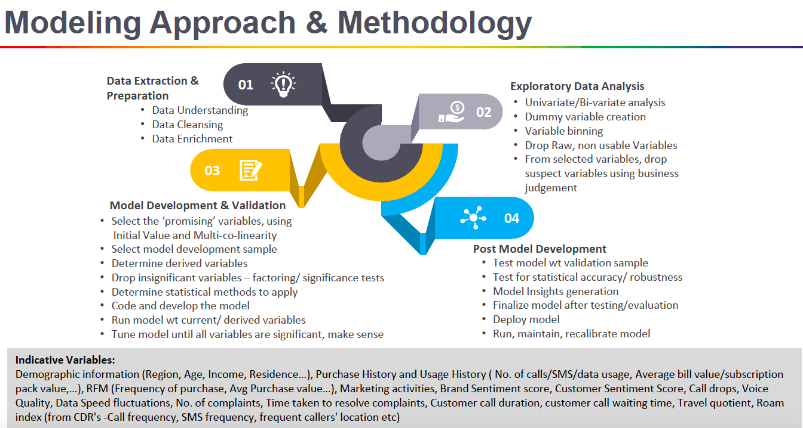
5. Solution Details
Steps:
Define Problem
Prepare Data
Data cleaning/Enrichment
EDA-Define the dataset/Variables
Model developemnt-Develop,Code,Tune Model
Model Evaluation
Improve Results.
Present Results.
Deploy Model
Run, Recalibrate model

Slide 7
5. Solution Details
Define Problem (Completed)
Telenor system churn is defied as inactivity of 105 days.
Therefore the behaviour trend need to be captured much before 105 days of silence.
Identify subscribers who tend to stop using services for X days based on the features determined.

Slide 8
5. Solution Details
SUB_MSISDN | MSISDN
SUB_SERVICE_PROVIDER | Circle
AON | Age of Nw in no of days
BALANCE | Balance as on D date
HANDSET_TYPE | 0-Others, 1-Feature Phone, 2-2G, 3-3G, 4-4G
RECHG_CNT_10DAYS_1 | No of recharge D-30 to D-20
RECHG_CNT_10DAYS_2 | No of recharge D-20 to D-10
RECHG_CNT_10DAYS_3 | No of recharge D-10 to D
DAYS_RECHG | Days since recharge
USG_VOC_OG_30DAYS | Voice OG usage D-30 to D
USG_VOC_OG_30_60DAYS | Voice OGusage D-60 to D-30
USG_VOC_IC_30DAYS | Voice IG usage D-30
USG_VOC_IC_30_60DAYS | Voice IG usage D-60 to D-30
USG_DATA_30DAYS | Data usage D-30 to D
USG_DATA_30_60DAYS | Data usage D-60 to D-30
USG_LOCAL_30DAYS | Local usage OG+IC D-30 to D
USG_STD_30DAYS | STD usage OG+IC D-30 to D
USG_INT_30DAYS | ISD usage OG+IC D-30 to D
USG_VAS_10DAYS_1 | VAS usage D-30 to D-20
USG_VAS_10DAYS_2 | VAS usage D-20 to D-10
USG_VAS_10DAYS_3 | VAS usage D-10 to D
LAST_USG_DAYS | Days since last usage
CC_CALLS_10DAYS | No of CC calls in last 10 days
CAMP_CNT | No of Campaign since last 60 days
DAYS_CAMP | Days since last campaign (2 month max)
segmentation | 0-0 , 1-IHV,2-SHV,3-SM
PI_Handset_migration | 1-Dual SIM, 0- Others
GENDER | 0-Male, 1 -Female ,2-Transgender
AGE | in Yrs.
ICR_RECH_CNT_60DAYS | No of ICR recharge in 60 days
USG_FLAG_21_27 | Usage flag for D+7: 0-No usage, 1- Usage > 0
2. Prepare Data (Completed)
A set of features defined as in the table
The defined features have been extracted for a sample date for analysis for D = 20-10-2017

Slide 9
5. Solution Details
3. Data cleaning (Completed)
Multiple irregularities were observed.
Sample data post cleaning is attached here
Key observations | Cleaning
Text outputs | Coverted to numerics for processing
Gender not available | Default assumption -male
HS type mismatch between BI & PI | BI considered master
Data Usage in GB | converted to bytes
Age found to be < 18 | Kept as it is.

Slide 10
5. Solution Details
4. Explore & Define the data-set (In Progress)
No of days of in-activity to be considered churn
USG_FLAG_21_27 | USG_FLAG_28_03 | USG_FLAG_04_10 | Total | %Age | Analysis
0 | 0 | 0 | 1,06,28,315 | 83% | Continued to be in non usage for 3 weeks
 |  | 1 | 7,81,301 | 6% | Started using in 3rd week
 | 1 | 0 | 4,48,445 | 4% | Started using in 2nd week, but again stopped in 3rd week
 |  | 1 | 9,25,082 | 7% | Started using in 2nd & 3rd week
Total Non usage in 7 days |  |  | 1,27,83,143
In the table , labelled as LOST is the most interesting.
First model to be created with ignoring nos labelled as GONE as to reduce influence of inactivity before the D date.
 | usage<0 in 0 to d-30 days | usage>0 in 0 to d-30 days
usage <0 in next 7 days | 69,79,872 | 58,03,271
 | GONE | LOST
usage >0 in next 7 days | 3,37,554 | 3,10,96,894
 | WB | ACTIVE
Further exploration is in progress

Slide 11
5. Solution Details
5. Implement Model
This is a typical classification problem where we want to predict y=0 or 1.
i) Model creation: Approx 1 lakh random samples will be used to create a model
ii) Once the model is created, it will be trained for complete base.
Result will be evaluated.
iii) Run the model for multiple days.
iii) Continuous iterations & fine tunings.
iv) Finalize the model.

Slide 12
6. Expected Results
We shall be evaluating the accuracy for the LOST case only.
Sample days | Precision ( % of correctly predicted against predicted churn) | Recall (% of correctly predicted against actual churn)
Day 1 | x% | y%
Day 2
Day 3

Slide 13



7. advantage
Increase retention
Using predictions, business ca run various promotions and offer schemes to retain customers.
Learning
Good learning & hands-on experience for the team on Machine Learning.
1st ML based showcase project
This is can be a ML based showcase project for Telenor India.

Slide 14
8. Team role:
Nimish Paneri
Puneet Breja
Area: Data Scientist
Key Activities: Feature finalization, ML implementation in python, , result evaluation & review .
Area: Data Analyst
Key Activities: Data extraction, exploration, feature finalization, result evaluation & review

Slide 15

Implementation Plan
XXXX
Problem Definition
17-11-2017
Data Finalization
10-12-2017
Model Evaluation
12-12-2017
1ST Cut result presentation
20.12.2017
Model Creation for full data
21-12-2017
Result Presentation
31-01-2018
Finalize & Implement
Date
Project End

